Slide 1


Slide 2

Raj Sharma (2215990046)
Harshit Yadav (2215990029)

Slide 3


Slide 4


Slide 5


Slide 6


Slide 7
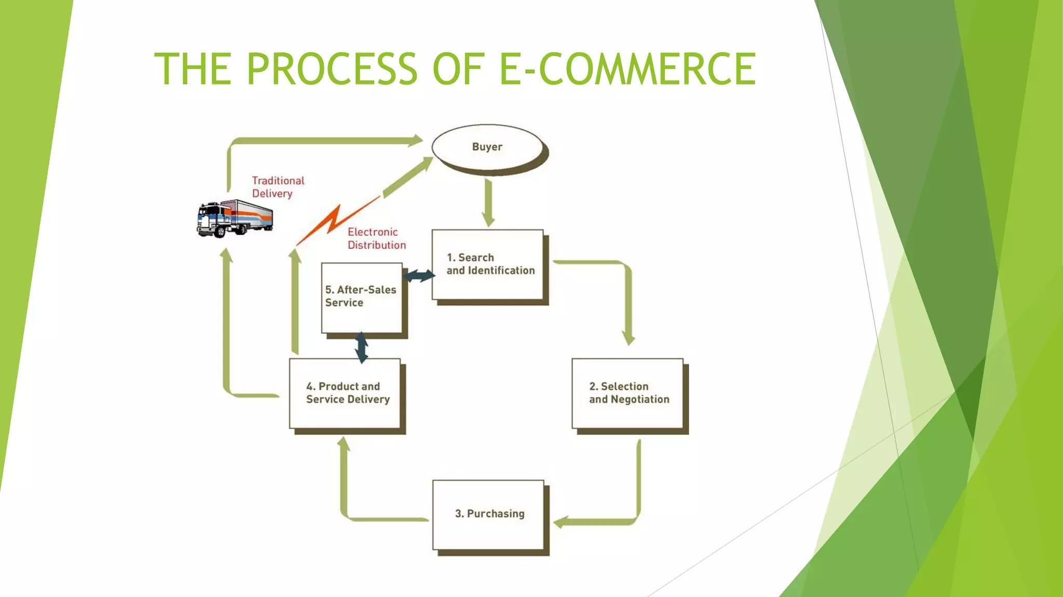

Slide 8


Slide 9


Slide 10
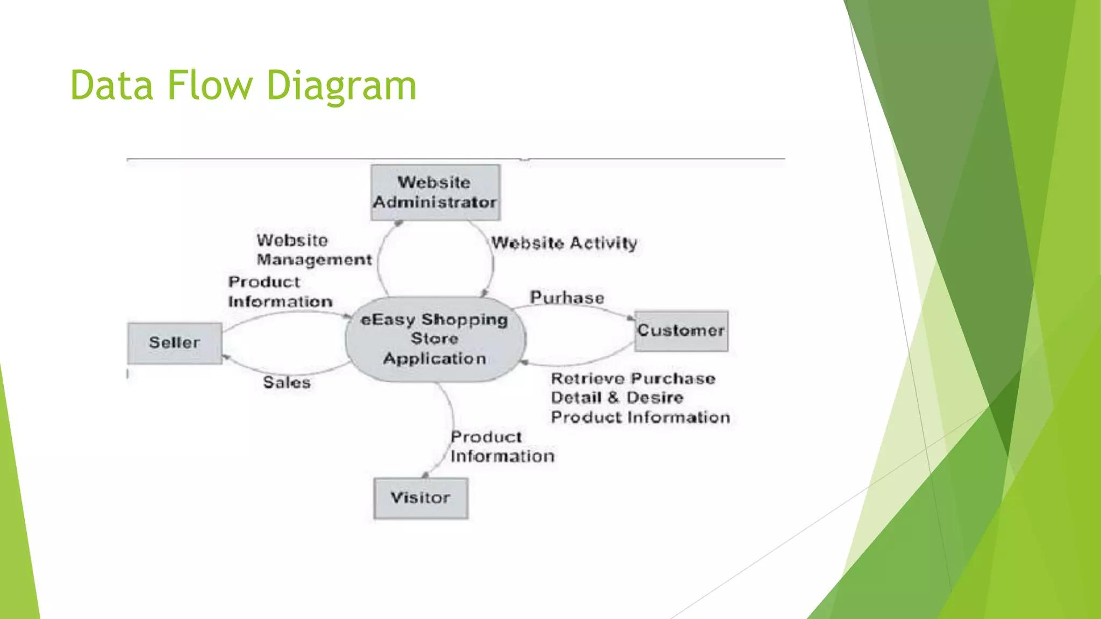

Slide 11


Slide 12
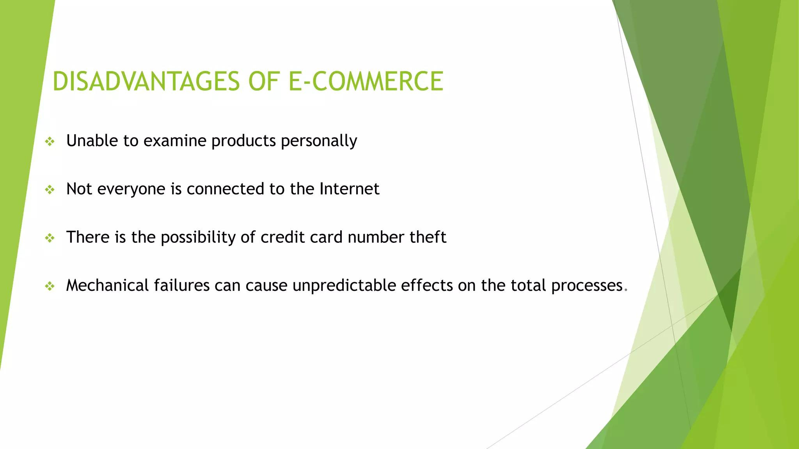

Slide 13


Slide 14


Slide 15

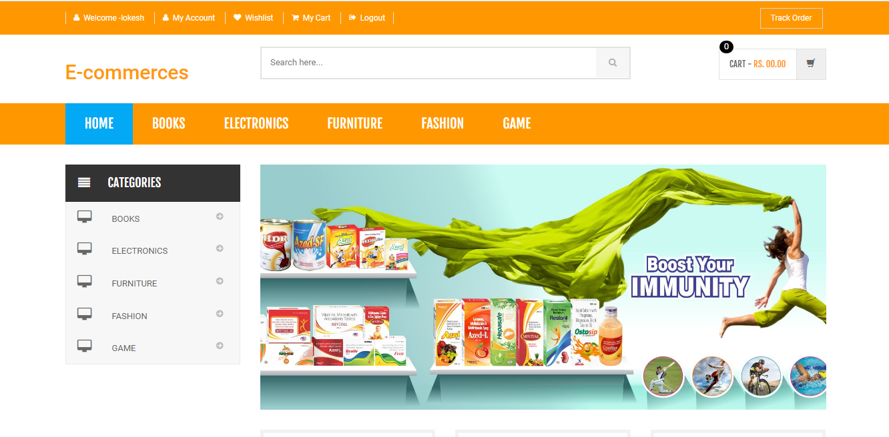

Slide 16

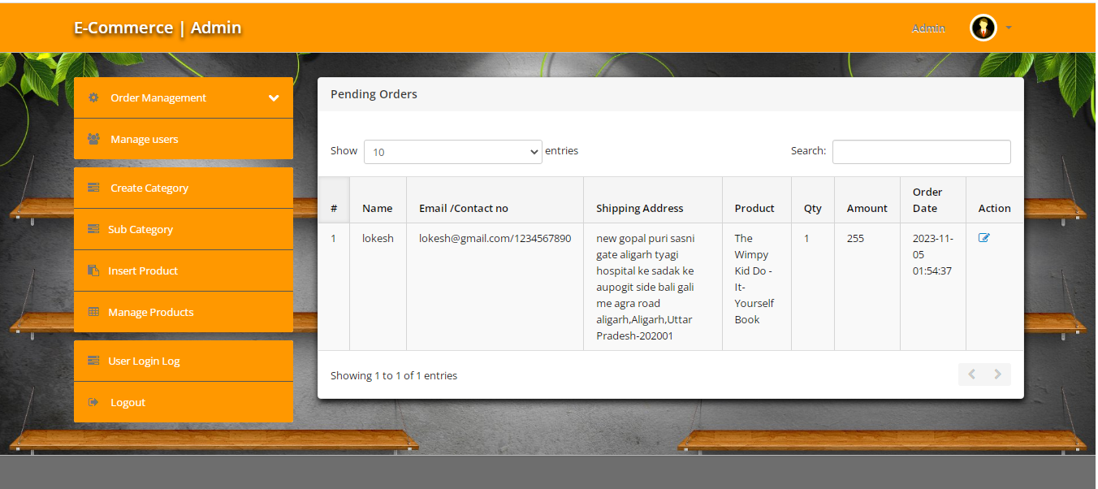

Slide 17

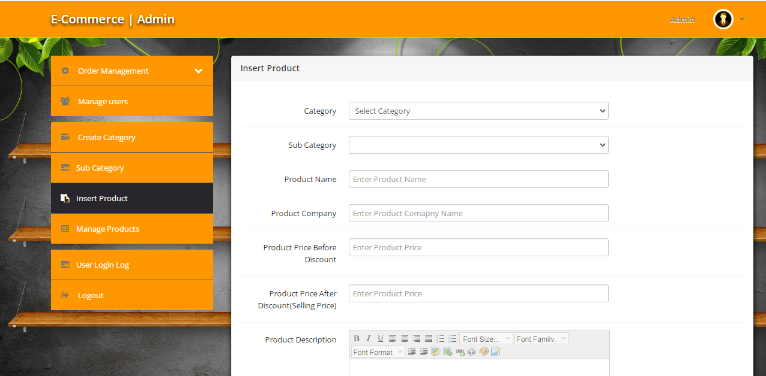

Slide 18

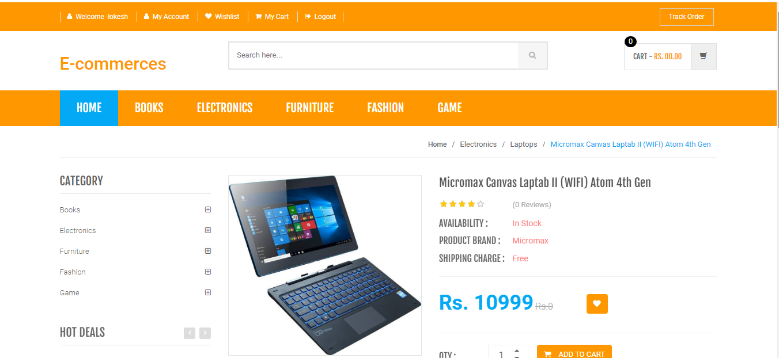

Slide 19

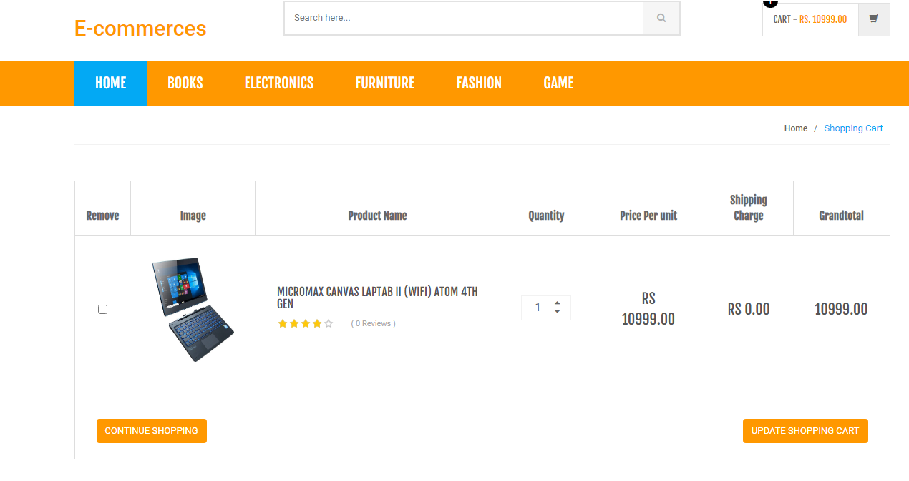

Slide 20

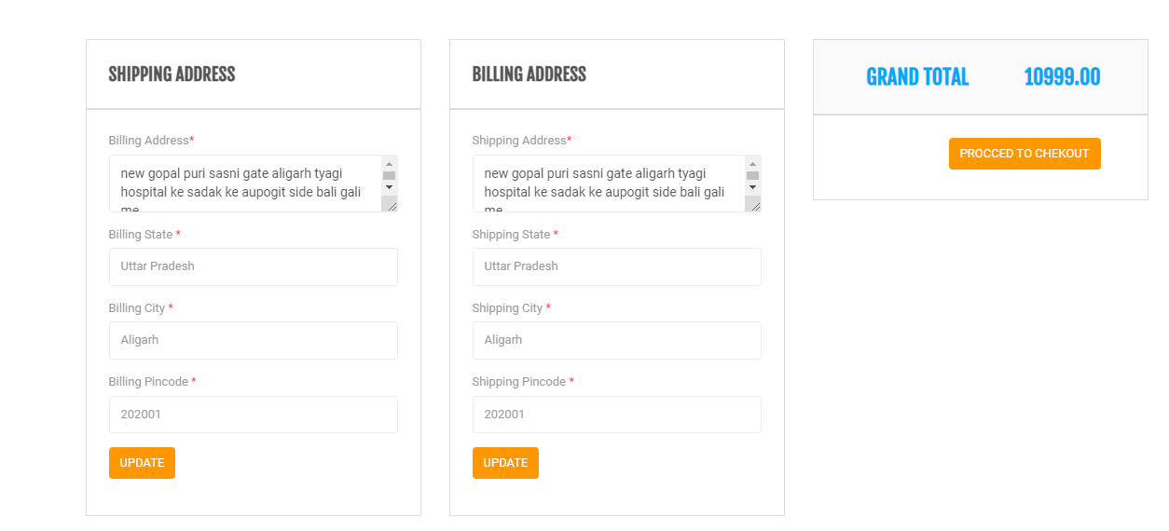

Slide 21


Slide 22


